Slide 1
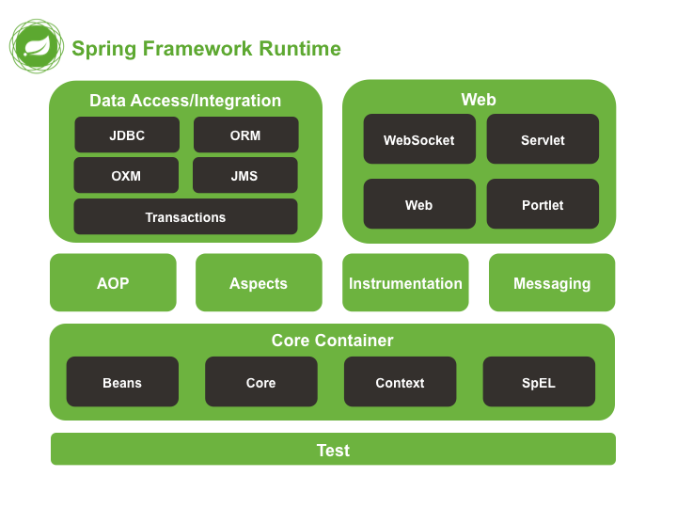
Introduction:
The spring framework is a JAVA platform that provides comprehensive infrastructure support for developing Java Application.
The Spring handle the infrastructure so you be able to focus on your application.
This capability applies to the Java SE programming model and to full and partial Java EE.
Provides the fundamental part of Spring,
include IoC and DI features
Provides the fundamental part of Spring,
include IoC and DI features
Provides the fundamental part of Spring,
include IoC and DI features
Provides the fundamental part of Spring,
include IoC and DI features

Slide 2
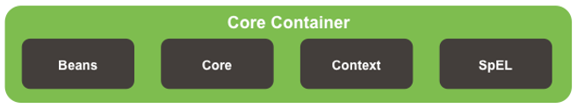
Spring Expression Language
Core Container:
Beans | Core | Context | Spring Expression Language
Provides the fundamental part of Spring, include IoC and DI features. |  | Builds on the solid base provided by the Core and Beans modules

